Slide 1
Welcome to Azure Defender + Azure Sentinel Better Together! Day 1

Slide 2
A look into Day 1
Kick-Off | 8:00-8:05 | Welcome | Main Call
 | 8:05-8:30 | Security Center + Azure Defender
 | 8:30-8:45 | Demo Walkthrough
Ingest | 8:45-9:00 | Break
 | 9:00-10:00 | Azure Defender Solutions
 | 10:00-11:00 | Activity: Data Lake Design & Security Considerations | Table Group Call
 | 11:00-11:15 | Break
 | 11:15-12:00 | Build Hands-on: Data Integration Part 1 | Table Group Call
Transform | 12:00-1:00 | Break | Main Call
 | 1:00-1:30 | Data Transformations
 | 1:30-2:00 | Activity: Data Engineering Discussion
 | 2:00-3:00 | Build Hands-on: Data Integration Part 2 | Table Group Call
 | 3:00-:15 | Closing | Main Call
Today we will be learning and collaborating across three spaces:
Main call (this meeting)
Table Group channel within the event Team
CloudLabs Learner Portal & Lab environment
Presentation/
Whole Group
Lab
Activity/ Discussion/ Group Work
Announcements

Slide 3
Security Center + Azure Defender

Slide 4
Azure Security Center

Slide 5
Azure Security Center
TODO
Notes:
TODO

Slide 6
Cloud Security
TODO
Notes:
TODO

Slide 7
Community Repository
TODO
Notes:
https://github.com/Azure/Azure-Security-Center

Slide 8
Azure Defender

Slide 9
Azure Defender
TODO

Slide 10
Log Analytics

Slide 11
Log Analytics
TODO
Notes:
The ? Mark is the knowledge center

Slide 12
Log Analytics – Tiers/SKUs
TODO
Notes:
The ? Mark is the knowledge center

Slide 13
Azure Agents
TODO
Notes:
The ? Mark is the knowledge center

Slide 14
Solutions
TODO
Notes:
The ? Mark is the knowledge center

Slide 15
Thank You slide
Break

Slide 16
Welcome Back!
7:00-7:05 | Welcome
7:05-7:15 | Keynote
7:15-7:45 | Demo Walkthrough
7:45-8:00 | Break
8:00-9:00 | Data Loading & Data Lake Organization
9:00-10:00 | Activity: Data Lake Design & Security Considerations | Table Group Call
10:00-10:15 | Break
10:15-11:00 | Build Hands-on: Data Integration Part 1 | Table Group Call
11:00-12:00 | Break | Main Call
12:00-12:30 | Data Transformations
12:30-13:00 | Activity: Data Engineering Discussion | Table Group Call
13:00-14:00 | Build Hands-on: Data Integration Part 2
14:00-14:15 | Closing | Main Call
Presentation/
Whole Group
Lab
Activity/ Discussion/ Group Work
Announcements

Slide 17
Azure Defender Solutions

Slide 18
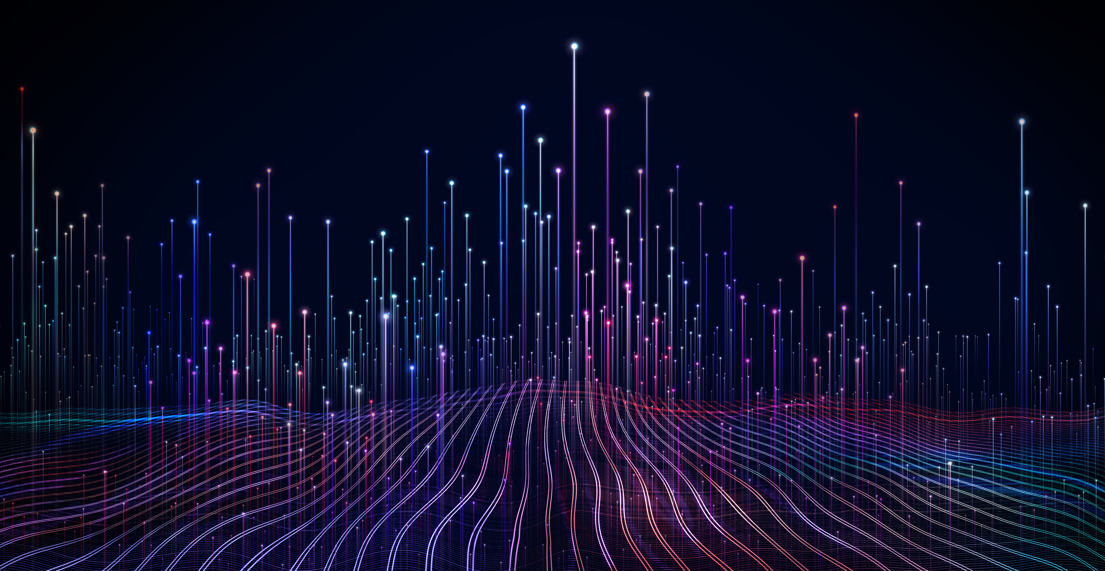
Agenda
1 Azure Defender Solutions
TODO
2 Best Practices
TODO

Slide 19
VM + SQL Vulnerability Assessments

Slide 20
Azure Defender – VM Vulnerability
TODO

Slide 21
Qualys Scanner
TODO
Notes:
Qualys Terms:
https://ascva.blob.core.windows.net/vadocs/ASC-Qualys-%20EULA.pdf

Slide 22
Azure Defender – SQL Vulnerability
TODO

Slide 23
File Integrity

Slide 24
File Integrity
TODO

Slide 25
Pop Quiz
Which one of these is NOT a component of a Synapse pipeline?
A) I.R.
B)
Linked Service
C)
Table
D) Activity

Slide 26
Container Image Scanning

Slide 27
Container Image Scanning
TODO

Slide 28
Adaptive Application Control
Notes:
Back to me

Slide 29
Adaptive Application Control
TODO

Slide 30
Adaptive Network Hardening
Notes:
Back to me

Slide 31
Adaptive Network Hardening
TODO

Slide 32
Just In Time VM Access
Notes:
Back to me

Slide 33
JIT VM Access
TODO

Slide 34
Network Map
Notes:
Back to me

Slide 35
Network Map
TODO
Notes:
The ? Mark is the knowledge center

Slide 36
IoT Security
Notes:
Back to me

Slide 37
IoT Security
TODO
Notes:
The ? Mark is the knowledge center

Slide 38
Best Practices

Slide 39


Question…
How many different methods of loading ADLS can you think of?
What about a Synapse SQL Pool?

Slide 40
Best Practices
TODO
Notes:
The ? Mark is the knowledge center

Slide 41
Session and Lab Environment

Slide 42
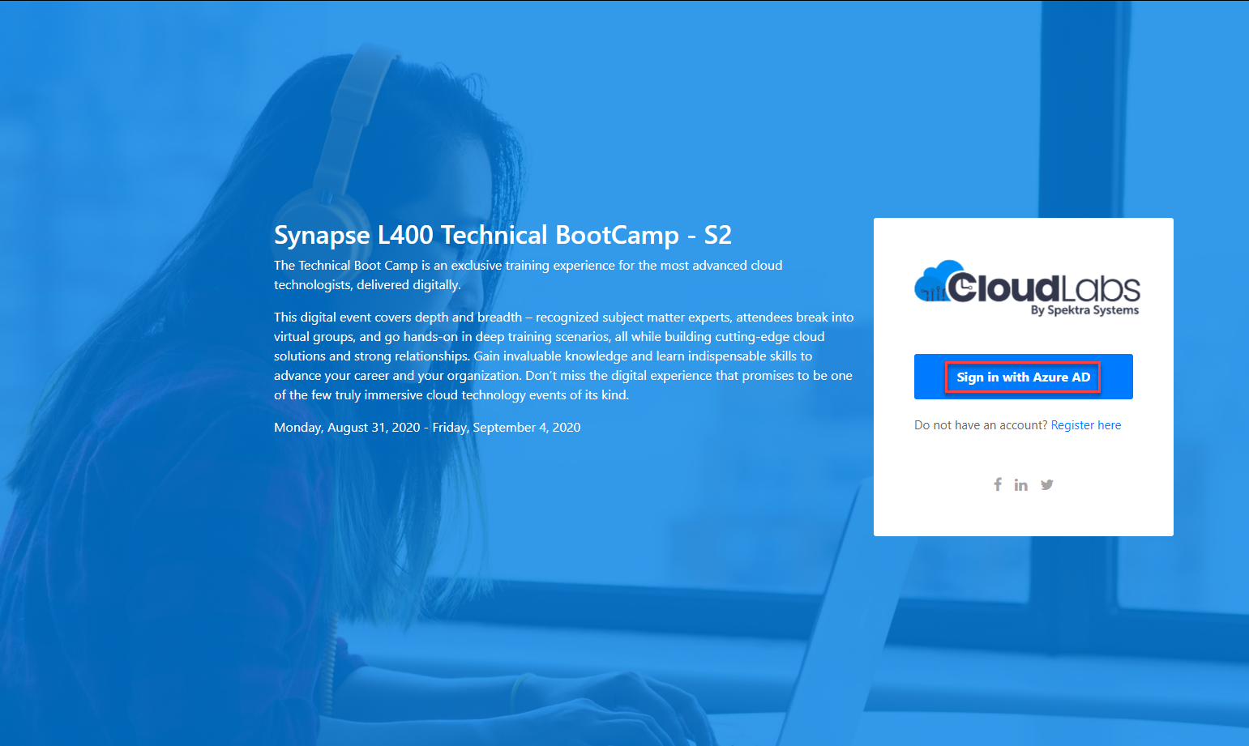
Login to the portal
Notes:
If they don’t have the emails.
Register link: https://bit.ly/32qwla3
Activation Code: ACTIVATE13799

Slide 43
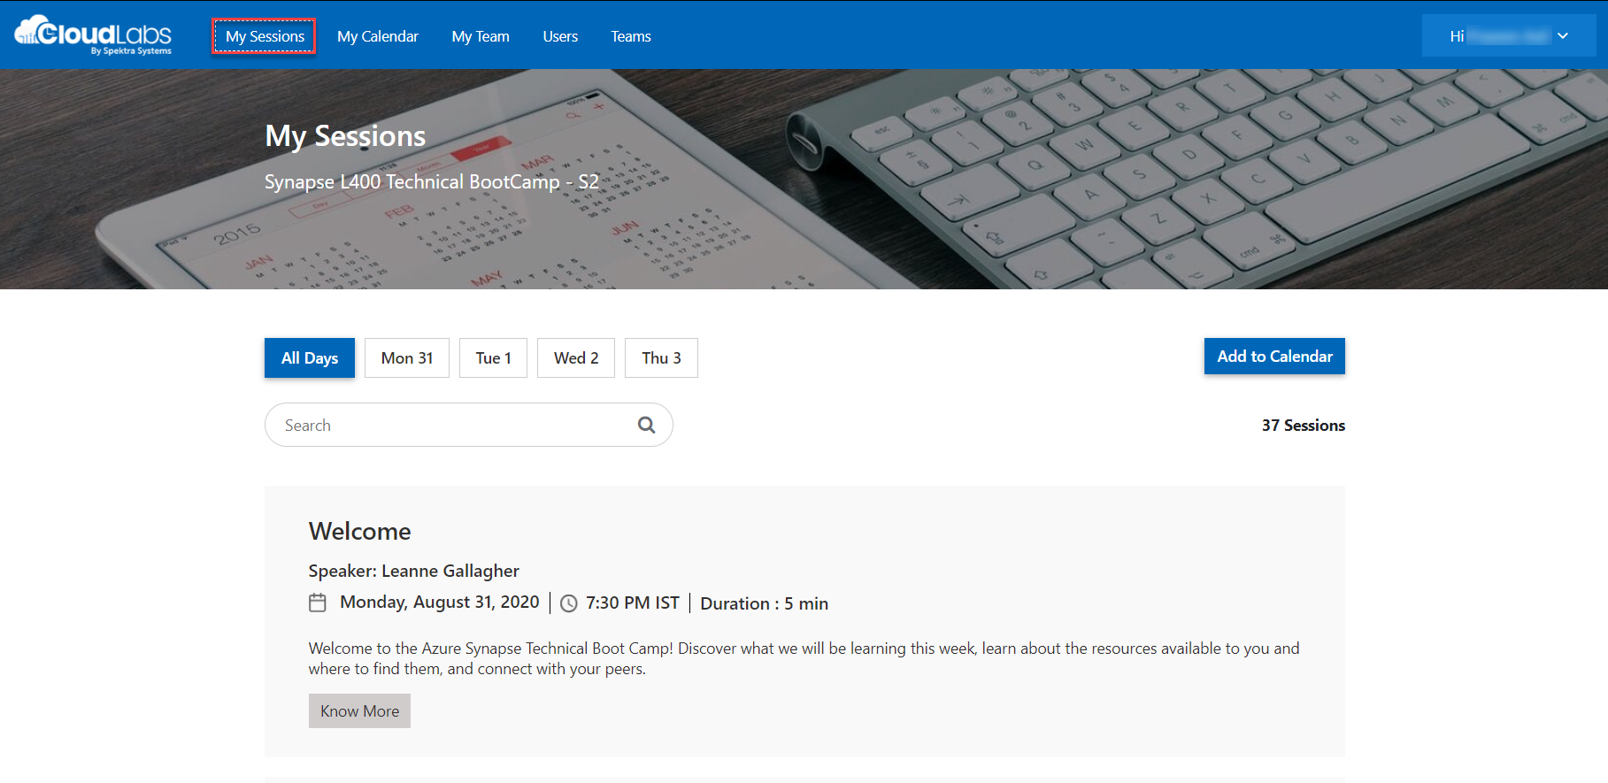
Sessions for Bootcamp

Slide 44
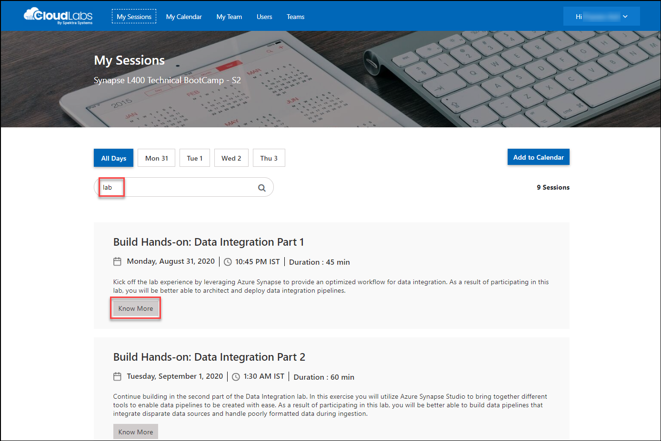
Search for lab
Search for lab
Click on Know More

Slide 45
Thank You slide
Break

Slide 46
DEMO: How to whiteboard designs

Slide 47
Breakout Activity: Data Lake Design & Security Considerations
As a result of participating in this activity, you will better be able to design, optimize and secure a file system within ADLS Gen2.
OUTCOMES
ACTIVITY
60 minutes
Learning Adviser
Table Group Channel
As a team review WWI requirements provided in student guide
Open the whiteboard and as a team answer the provided challenge questions.
The questions are pre-loaded into the whiteboard.
Welcome | Keynote | Demo Walkthrough | Break | Data Loading & Data Lake Organization | Activity: Data Lake Design & Security Considerations | Break | Lab: Data Integration Part 1 | Break | Data Transformations | Activity: Data Engineering Discussion | Lab: Data Integration Part 2 | Closing

Slide 48
DEMO: How to access your lab environment

Slide 49
Build Hands-on Lab: Azure Defender Part 1
As a result of participating in this lab, you will be better able to deploy azure defender protections
OUTCOMES
ACTIVITY
60 minutes
Independent
Table Group Channel & CloudLabs Environment
Independently review and complete Exercises 1-4 in the Lab 1 Guide.
Login to your CloudLabs environment and work through a set of tasks you would typically follow in work associated with ingesting and integrating your customer’s data.
The Lab Guide is available in the ‘Files’ tab of the General channel. Engage your Table Group call for support and troubleshooting.
Welcome | Keynote | Demo Walkthrough | Break | Data Loading & Data Lake Organization | Activity: Data Lake Design & Security Considerations | Break | Lab: Data Integration Part 1 | Break | Data Transformations | Activity: Data Engineering Discussion | Lab: Data Integration Part 2 | Closing

Slide 50
Welcome Back!
8:00-8:05 | Welcome | Main Call
8:05-8:15 | Keynote
8:15-8:45 | Demo Walkthrough
8:45-9:00 | Break
9:00-10:00 | Azure Defender File Integrity + Container Image Scanning
10:00-10:15 | Break | Table Group Call
10:15-11:15 | Azure Defender Adaptive Application Control + Adaptive Network Hardening
11:15-12:15 | Build Hands-on: Azure Defender Part 1
12:15-1:15 | Break | Main Call
1:15-2:15 | Azure Defender VM/SQL Vulnerability Assessments | Main Call
2:00-3:00 | Activity: Data Engineering Discussion | Table Group Call
3:00-4:00 | Build Hands-on: Azure Defender Part 2
4:00-4:15 | Closing | Main Call
Presentation/
Whole Group
Lab
Activity/ Discussion/ Group Work
Announcements

Slide 51
Thank You slide
Thank you

Slide 52
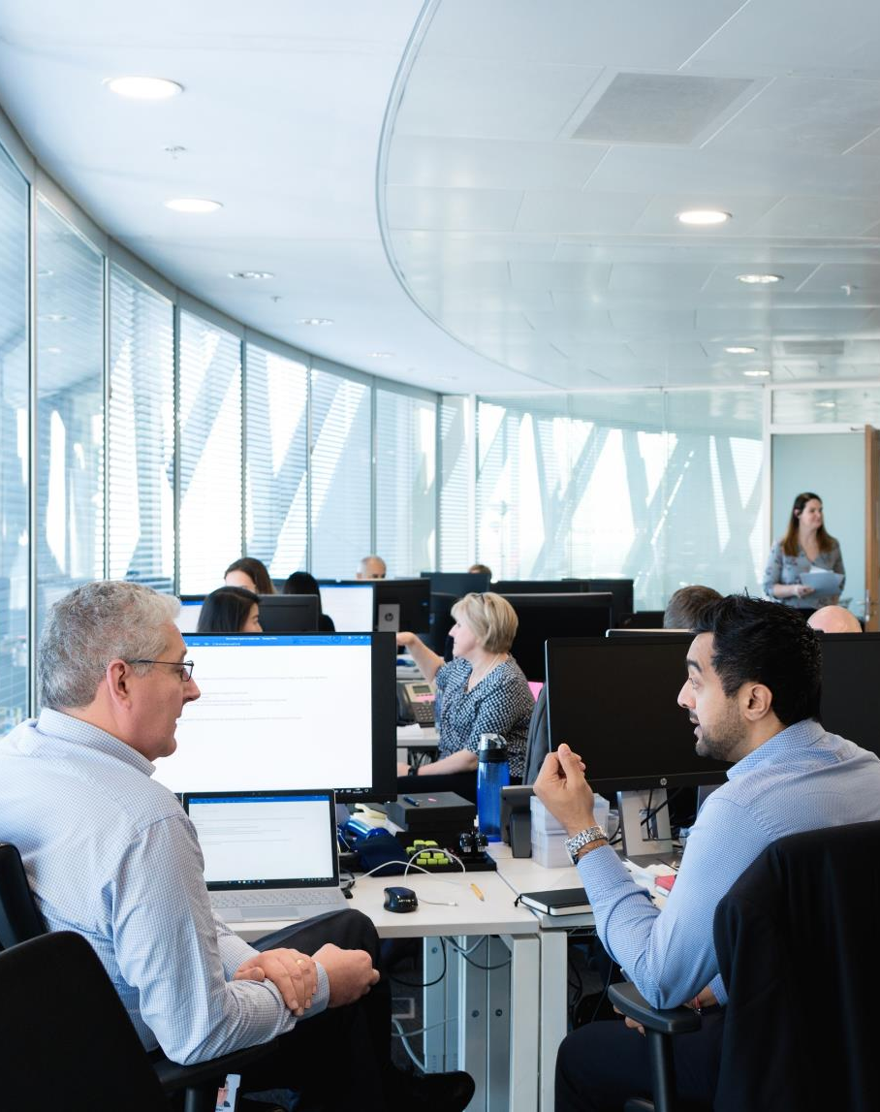
Full Group Activity: Azure Defender
Objective: As a result of participating in this activity, you will better be able to TODO.
What you will be doing: The facilitator will be posting questions to the entire group using an interactive tool called Mentimeter. The answers you post using Mentimeter will then drive the discussion.
Total Activity Time: 30 minutes

Slide 53
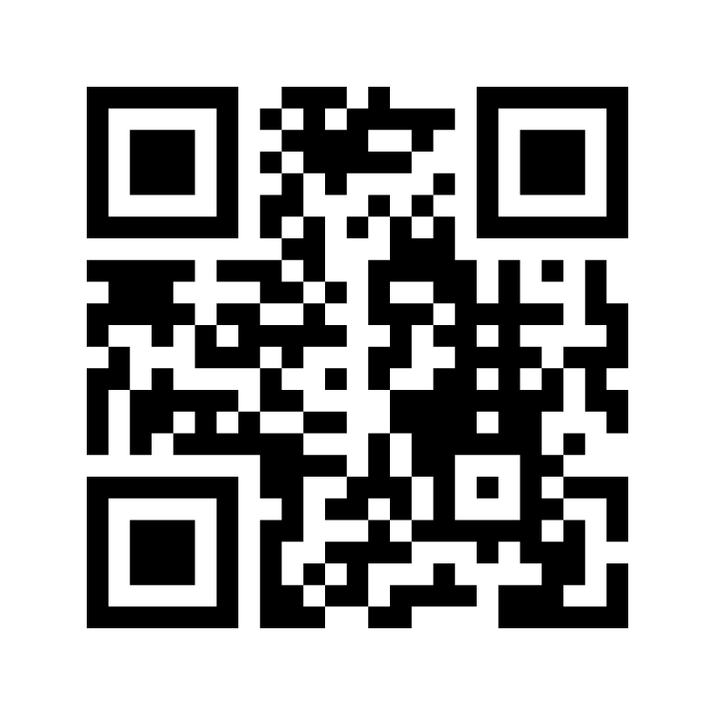
Mentimeter Poll
Scan QR Code
or Go to www.menti.com and use code
1183 9575
Notes:
https://www.menti.com/9r2wwujwag

Slide 54
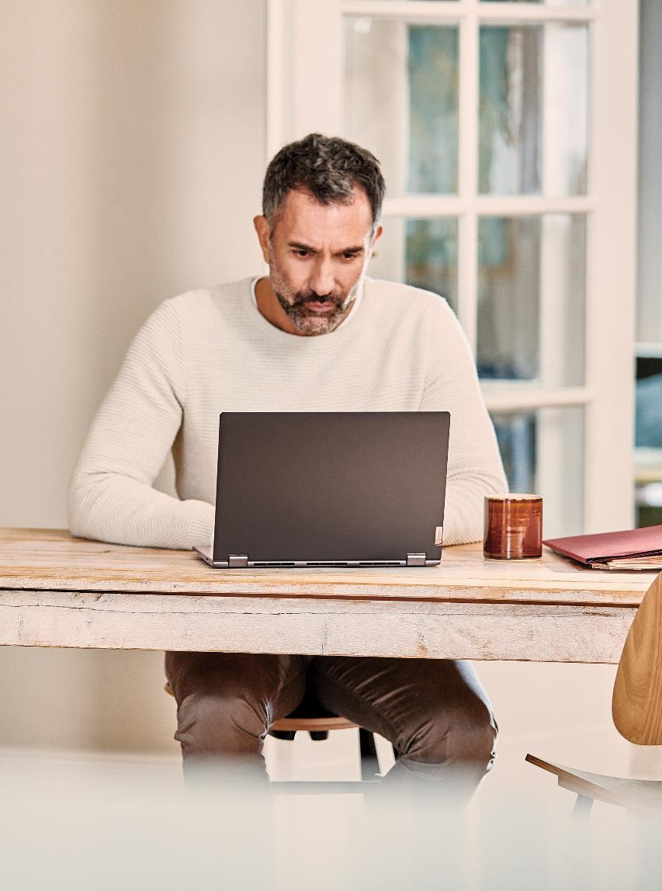
Hands-On Build Activity: Azure Defender Part 2
Objective: As a result of participating in this lab, you will be better able to TODO.
What you will be doing: Like the Part 1 exercise, you work individually in your lab environment to complete a set of tasks you would typically follow in work associated with ingesting and integrating your customer’s data. A set of tasks are outlined for you to follow and complete.
Total Activity Time: 60 minutes

Slide 55


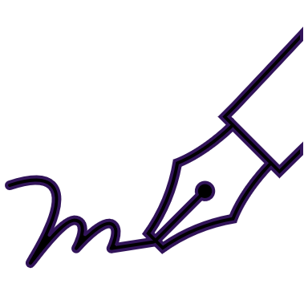






Lab: individual lab exercise
Step 1: Go to your table group channel
Step 2: Your Learning Adviser will provide you a unique cloud lab login link
Step 3: Login and begin the lab. Engage your table group via a Microsoft Teams “meet now” call to support each other (meet now button in upper right corner of application)

Slide 56
Closing
Thank you for your participation in today’s Azure Synapse Technical Boot Camp!
We learned:
File Integrity
Adaptive Application and Network Hardening
VM and SQL Vulnerability Assessment
Container Instance Monitoring
TODAY
We will learn to:
Azure Sentinel
Azure Sentinel + Azure Defender
TOMORROW

